Slide 1




Group 5

Slide 2
Preface

Slide 3
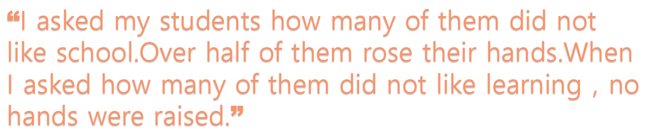
School,an institution designed for learning.
Why did school become so widely hated by people who love learning？

Slide 4
What went wrong？

Slide 5
Problem
Part 1

Slide 6
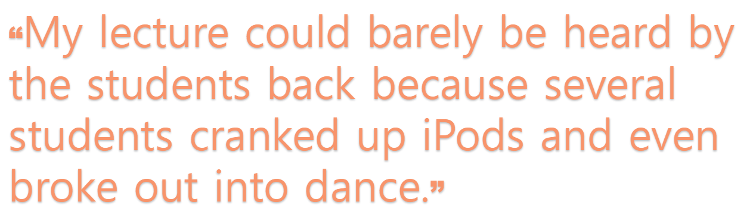
“The students were undoubtedly engaged，just not with me.”

Slide 7
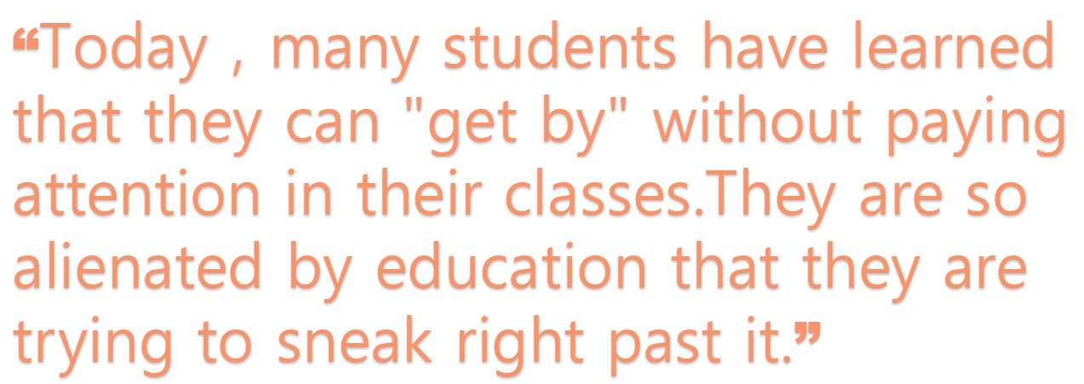

Slide 8
“While some simply blamed the problems on the students themslves，others recognized a broader pattern.Most blamed technology，though for very different reasons.Some simply suggested that new technologies are too distracting and superficial and that they should be banned from the classroom.Others suggested that students are now “wired” differently.”

Slide 9

“Some time ago we started taking our walls too seriously—not just the walls of our classrooms,but also the metaphorical walls that we have constructed around our "subjects,""disciplines,"and"courses."”

Slide 10
Solution
Part 2

Slide 11
We are expected
not to make
the Walls

Slide 12
We don't have to tear the walls down.

Slide 13
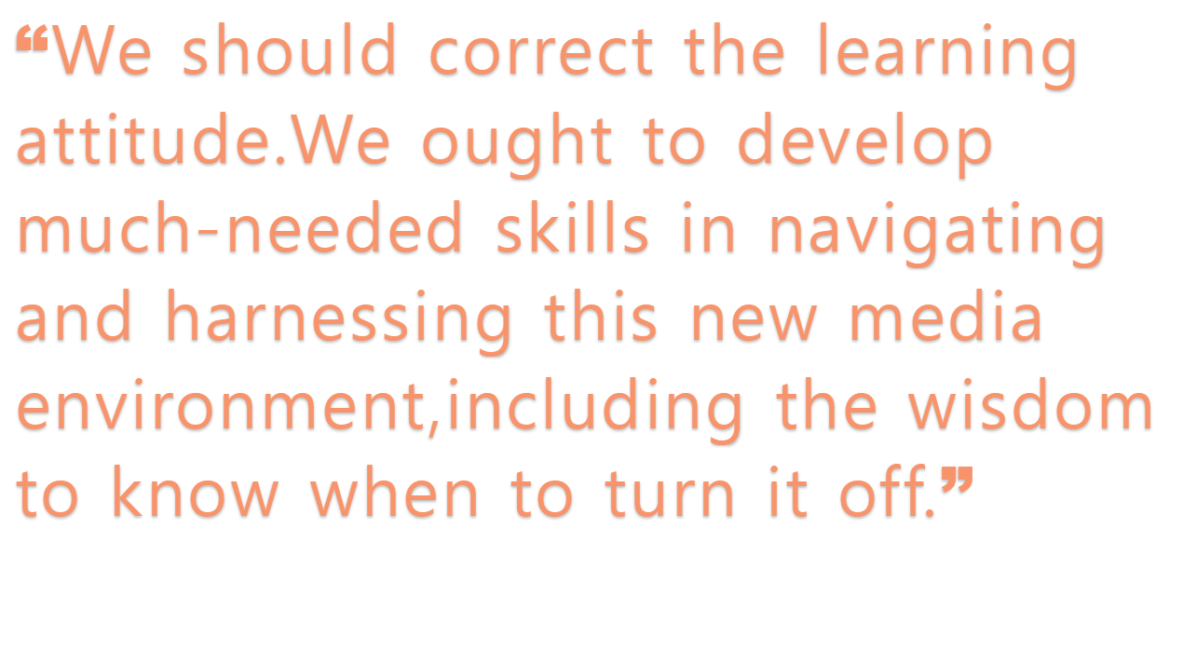
For students

Slide 14
For teachers
“Teachers ought to stop pretending that the walls separate us from the world，and begin working with students in the pursuit of answers to real and relevant questions.”

Slide 15
We welcome digital information into our classrooms as learning technologies rather than distractions.

Slide 16
THANK YOU
For Listenig

